Slide 1

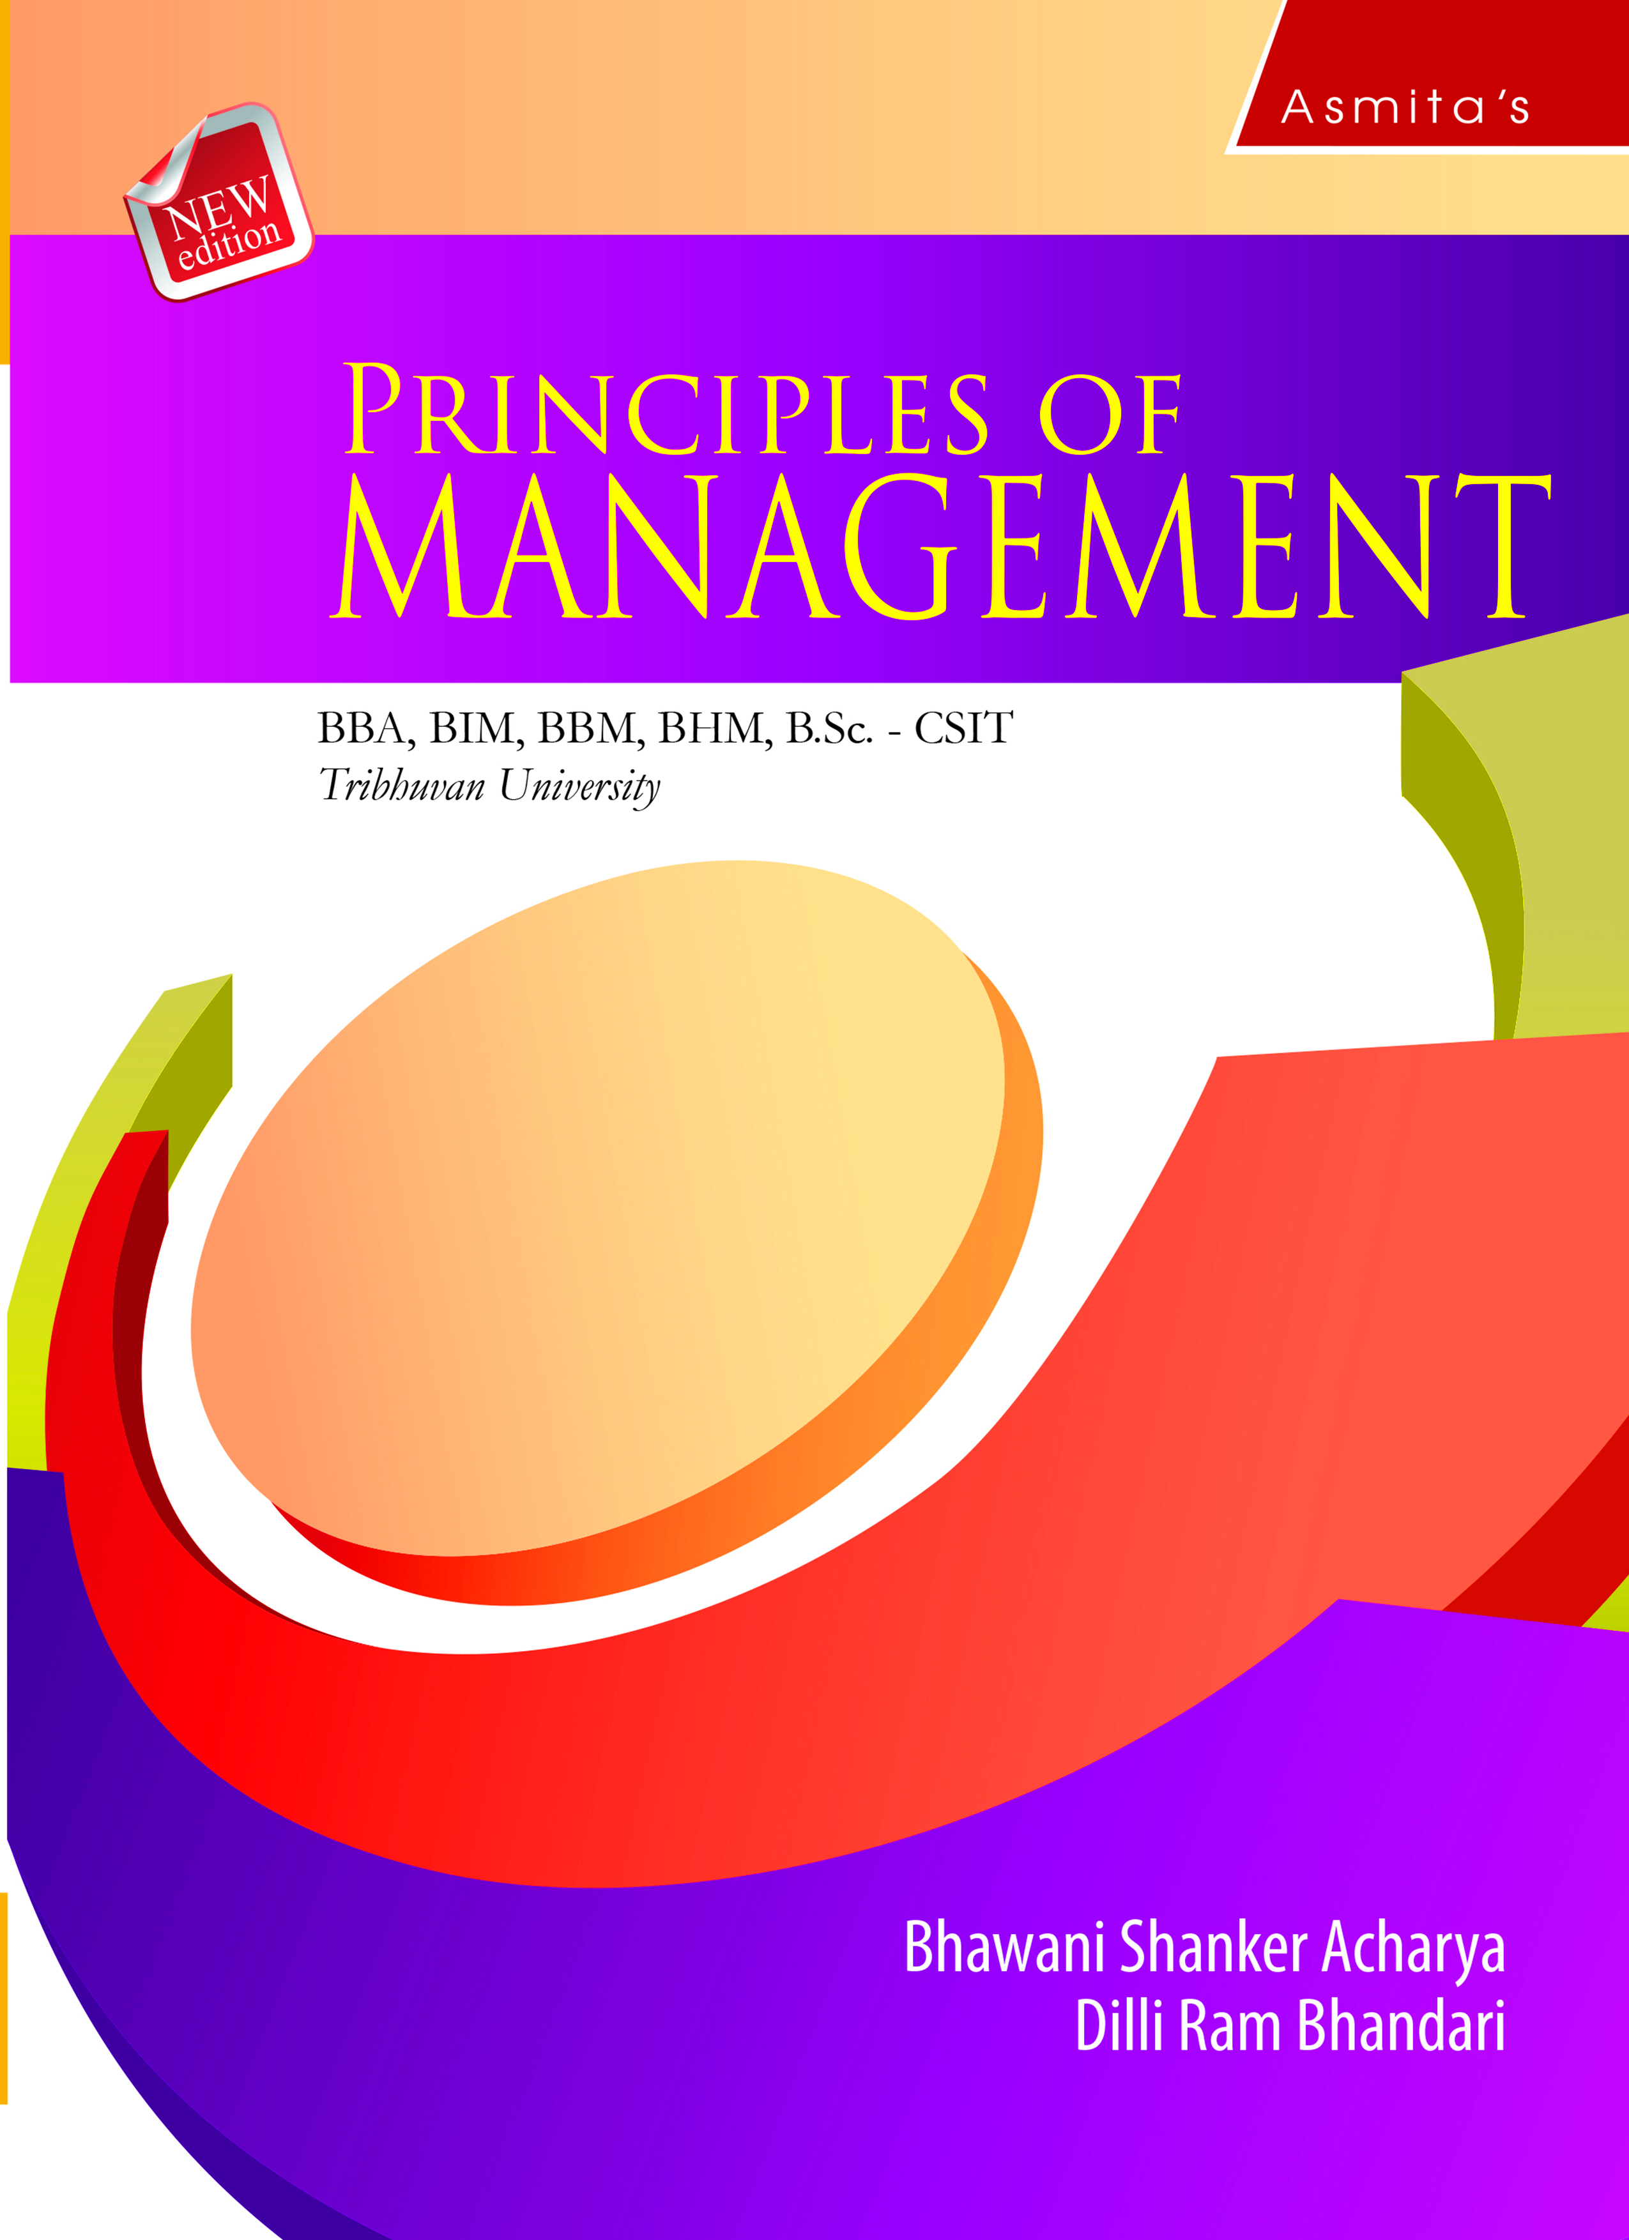
Communication
Chapter 9

Slide 2
LEARNING OBJECTIVES
After studying this chapter, the students are expected to;
Understand the concept, features, importance, process and structure/networks of communication.
Discuss the concept, benefits and enhancing of active listening.
Know the types of communications.
Understand the barriers to effective communication.
Know how to enhance effective communication/overcoming barriers.

Slide 3
Concept of Communication
It is a process by which information is exchanged between individuals through a common system of symbols, signs, or behavior. More specifically, it is the transfer and understanding of meaning. The effective communicate is a necessary condition for managerial functions such as planning, organizing, staffing, leading, and controlling. Communication is vital to organizations for coordinating actions and achieving goals.

Slide 4
Features of Communication
The following are the features of communication.

Slide 5
Importance of Communication
The following are the importance of communication in an organization.

Slide 6
Process of Communication
Communication process involves a number of steps which are linked together. They are;

Slide 7
Structure/Networks of Communication
Communication structure refers to the pattern through which organizational members communicate each other. It may also be termed as communication channel or network.

Slide 8
1. Wheel Structure
Under the wheel (star) network structure, the leader works as a center of communication. She/he accumulates information and disseminates it to all the members of the organization as well as the outsiders. Hence, the leader acts as the source of information. In this structure, subordinates are not supposed to communicate with each other. Sometimes, they do not even know of the existence of other members of the same group.

Slide 9
2. Chain Structure
The chain network has the vertical upward and downward form of formal chain of communication. In this structure, an employee can communicate only with his immediate superior and subordinate. Hence, communication takes place under a chain from the higher level to the subordinate levels and also from the subordinate levels to the higher level. This type of network is common in all organizations following hierarchy of authority and responsibility.

Slide 10
3. Circle Structure
It follows a horizontal or sideward form of communication network. With this network, a person can only communicate to the person next to his right or left. He cannot even communicate with any other member of the same group.

Slide 11
4. All Channel Structure
The all channel communication structure blends the features of the circle and the wheel structures. It allows each member to communicate directly with every other member. This structure is highly effective for solving complex problems, as it allows all participants to contribute to solving the problem. This pattern is more decentralized and allows a free flow of information among all group members.

Slide 12
Concept of Active Listening
Active listening is a process of actively listening and sensing the sender’s messages or signals, evaluating, and responding them properly. It is essential for improving communication effectiveness. Active listening involves listening with all senses by giving full attention to the sender or speaker. Besides, it also involves showing verbal and non-verbal signs of listening. Let's examine some definitions of active listening.

Slide 13
Benefits of Active Listening
Active listening skills are very important in workplace. The following are the benefits of active listening.
Builds connections between the sender and receiver
Builds trust in workplace
Helps to identify and solve problems
Helps to increase knowledge and understanding on various issues

Slide 14
Enhancing Active Listening
The following are the major ways for enhancing active listening.
1. Pay attention
2. Show the sign of listening
3. Provide feedback
4. Respond appropriately

Slide 15
Types of Communications
In an organization, communication takes place in many ways and types. Some of them are formal and informal communication, interpersonal communication and non-verbal communication.

Slide 16
Formal Communication
The communication that flows through the formal organizational structure is called formal communication. It may take place between a superior and a subordinate, a subordinate and a superior and among the subordinates or managers. It may be oral or written and kept as a record for future reference. Formal communication may be vertical communication and horizontal communication.

Slide 17
Informal communication
Informal communication is the communication that takes place in an organization without the formal channels. It is often called the ‘grapevine’ as it spreads throughout the organization and in all directions without consideration of the levels of authority.

Slide 18
B. Interpersonal Communication
Interpersonal communication is one of the basic means of communication. It is the exchange of information between two or more people. It came into being when people began to exchange ideas and thoughts with one another. Under this, people communicate their feeling, ideas, emotions and information face to face with each other. It can be in verbal or non-verbal form. The interpersonal communication skills can be improved by practice, knowledge and feedback.
Interpersonal communication may take place orally or in written form.
1. Oral communication
2. Written communication

Slide 19
C. Non-verbal Communication
Contrary to oral and written communication, non-verbal communication includes facial expressions, the tone and pitch of the voice, gestures displayed through body language and the physical distance between the communicators. Hence, non-verbal communication is the process of sending and receiving messages without using words, either spoken or written. This type has become most complex and important type of communication in recent years.

Slide 20
Barriers to Effective Communication
There are several barriers to effective communication.

Slide 21
Enhancing Effective Communication/Overcoming Barriers
The managers should try to enhance the effectiveness of communication which may be enhanced through individual and organizational skills.

Slide 22
Thank you

