Slide 1

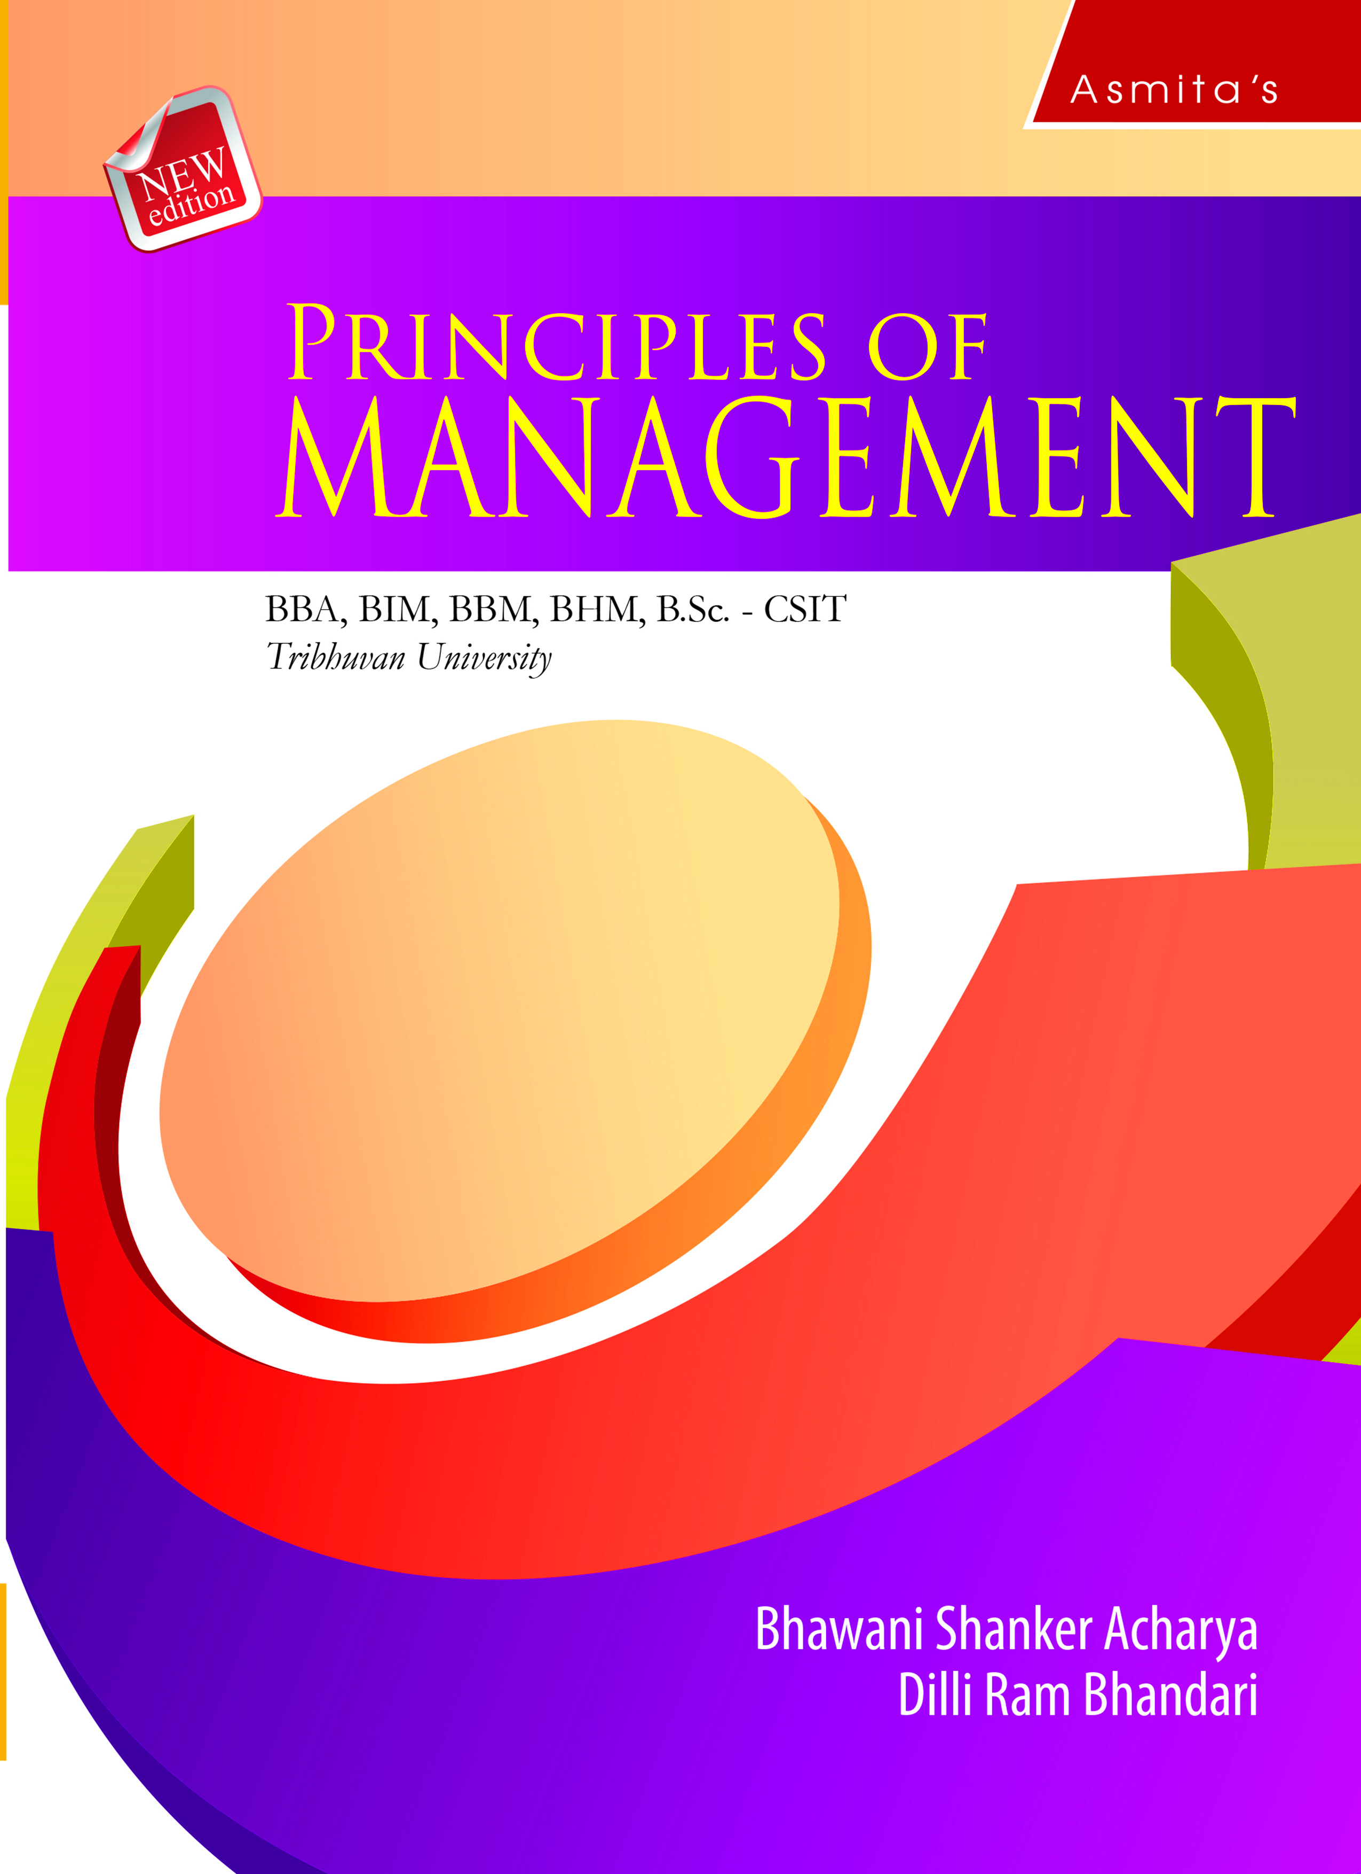
Motivation
Chapter 8

Slide 2
LEARNING OBJECTIVES
After studying this chapter, the students are expected to;
Understand the concept and features of motivation.
Know the process and importance of motivation.
Explain the techniques of motivation.
Discuss the theories of motivation.

Slide 3
Concept of Motivation
The term motivation is derived from the Latin word movere which means “to move”. In simple words, it is the will to work. Hence, motivation may be defined as the set of forces that leads people to behave in a particular way. It is the most difficult factor to manage. The performance of an employee is a function of his abilities and motivation. Motivation is basically a psychological process. It is one of the most complex and important concept or function of the managers.

Slide 4
Features/Characteristics of Motivation
Motivation is a multi-dimensional concept. It has the following characteristics.

Slide 5
Process of Motivation
A simple model of motivation process is given below.

Slide 6
Importance of Motivation
The importance of motivation is discussed below.

Slide 7
Techniques of Employee Motivation
Some of the major motivational techniques which are frequently used by managers to get better performance are discussed below.

Slide 8
Thank you

