Slide 1

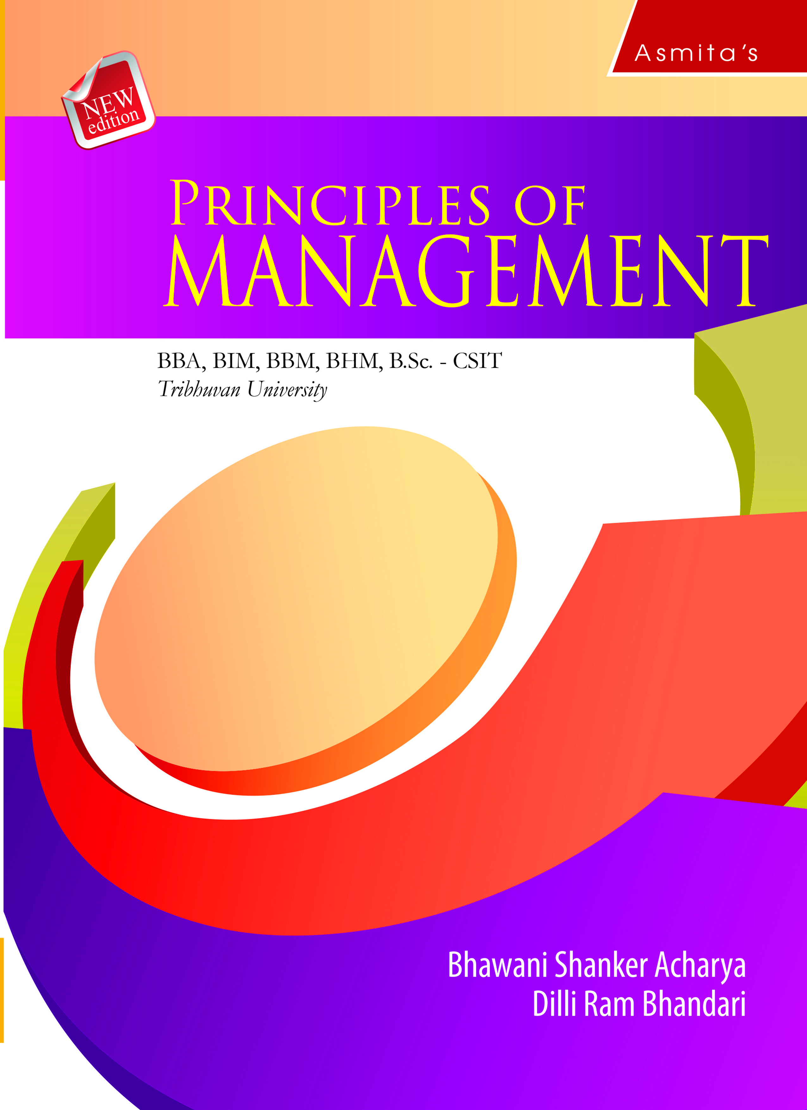
Decision Making
Chapter 5

Slide 2
LEARNING OBJECTIVES
After studying this chapter, the students are expected to;
Know the concept, features of decision making.
Understand the elements of decision situation.
Explain the types of decisions making.
Know process and approaches of decision making.
Analyze the decision making conditions.

Slide 3
Concept of Decision Making
A decision can be defined as a course of action purposely chosen from a set of alternatives to achieve organizational goals. Hence, decision making is a process of selecting the best alternative among the available alternatives.

Slide 4
Nature/Features of Decision Making
The major features of decision making are:
1. Selective process
2. Human and rational process
3. Dynamic process
4. Goal oriented
5. Continuous process
6. Freedom to decision maker
7. Positive or negative impact

Slide 5
Elements of Decision Situation
Decision making involves a number of situations which may be explained as below.
1. The decision makers
2. Organizational goals
3. The environment
4. Urgency
5. Scope

Slide 6
Types of Decisions Making
Managers make a number of decisions with different nature. They may be categorized in a number of ways.

Slide 7
Types of Decisions Making …(contd)
1. Decision Types by Structure
a. Programmed decisions
b. Non-programmed decisions
2. Decision Types by Importance
a. Major decisions
b. Minor decisions
3. Decision Types by Nature
a. Routine decisions
b. Strategic decisions
4. Decision Types by Complexity
a. Simple decisions
b. Complex decisions
5. Decision Types by Number of Persons Involved
a. Individual decisions
b. Group decisions

Slide 8
Process of Decision Making
The following are the processes or steps involved in a rational decision making process.
1. Identification of problem or opportunity situation
2. Identification of possible alternatives
3. Evaluation of alternatives
4. Selection of the best alternative
5. Implementation of the chosen alternative
6. Follow up and evaluation of results

Slide 9
Approaches of Decision Making
There are three approaches to decision making. They are based on rationality, bounded rationality and intuition.
1. Classical or Rational Approach: Classical or rational decision making approach assumes that decision making is (or should be) a rational process.
2. Behavioral or Bounded Rationality Approach: Bounded rationality is an idea that states the decision-making capacity of humans cannot be fully rational because of a number of limitations.
3. Intuitive Approach: The intuitive decision making approach is making decisions on the basis of experience, feelings and accumulated judgment.

Slide 10
Decision Making Conditions
There are three major conditions of decision making. They are discussed below.
1. Decision making under certainty
2. Decision making under risk
3. Decision making under uncertainty

Slide 11
Tools for Decision Making
A number of tools may be used while making decisions. They are:
Linear programming
Simulation
Payoff matrix
Decision Tree
Queuing model
Game theory
Accounting tools

Slide 12
Thank you

