Slide 1


Organizational Change and Development
Chapter 11

Slide 2
LEARNING OBJECTIVES
After studying this chapter, the students are expected to;
Know the concept of organizational change (OC)
Understand the nature/features of OC
Explain the forces of OC
Discuss the paradigm shift in OC
Know the areas of OC
Understand resistance to change
Know the approaches to managing OC
Understand the concept, characteristics and process of organizational development (OD),
Discuss OD interventions

Slide 3
Concept of Change
Organization change is about reviewing and modifying management structures and business processes. Organization change occurs when business strategies or major sections of an organization are altered.

Slide 4
The Language of Organizational Change
Concept | Explanation
The learning organization | The notion that learning is central to success and effectiveness. Management must learn to see the "big picture" and understand fine relationships among parts of the system.
Reengineering | A fundamental rethinking and redesign of systems and processes. Work should be organized around outcomes, not tasks or functions.
Core competencies | The notion that companies need to identify and organize around what they do best. Strategy should be based on these core competencies rather than products or markets.
Organizational architecture | The idea that managers need to think broadly about the organization in terms of how work, people, and designs fit together.
Time-based competition | The notion that time is money. Time is manageable and can be a source of competitive advantage affecting productivity, quality, and innovation.
Growth strategies | Methods to lift profits by expanding revenues, not just cutting costs.
Mission and vision statements | Description of what the company will become and how it will get there.
Strategic alliances | Ways to create business partnerships among customers, suppliers, and even competitors.

Slide 5
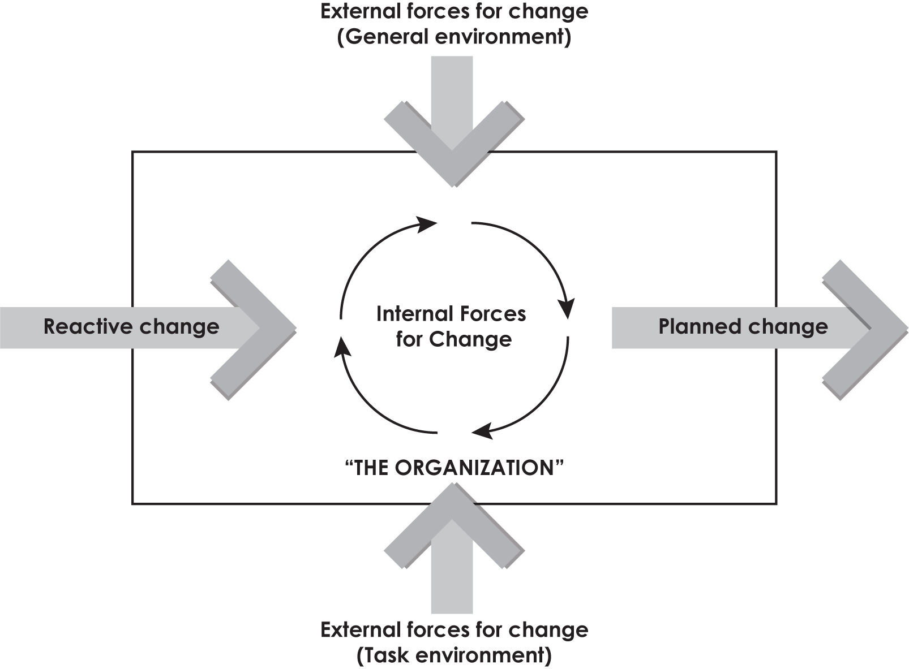
Nature of change: Features (Characteristics)
The nature of organizational change can be better understood by analyzing the following characteristics (features) of it:
A. Features/Characteristics
1. Outcome of pressure
2. Effects whole organization
3. Differs in rates of speed and degree
4. Derivative of problems of growth
5. Part of organizational life
6. Can be reactive and planned
7. Creates new equilibrium
8. Continuous and pervasive activity
9. Demands change agent
B. Types of Change

Slide 6
Forces of Change: Factors Responsible for Change
We (managers) need to swim according to the flow of river. The river is not going to follow us. The reality of modern organization is to face a dynamic and changing environment. A number of factors are attacking the organization making the change inevitable. Table given below summarizes six specific forces that are acting as stimulants for change. Following six forces are the major forces. There are other forces as well but we do not describe them here because they are less important factors.

Slide 7
Forces for Change
Force | Examples
Nature of the workforce | ❑ More cultural diversity  Aging population  Increased immigration and outsourcing
Technology | ❑ Faster, cheaper and more mobile computers  Handhold devices  Emergence and growth of social networking sites
Economic shocks | ❑ Rise and fall of global housing market  Financial sector collapse  Global recession
Competition | ❑ Global competitors  Mergers and consolidations  Increased government regulation of commerce
Social trends | ❑ Increased environmental awareness  Liberalization of attitudes toward gay, lesbian, and transgender employees  More multitasking and connectivity
World politics | ❑ Rising healthcare costs  Opening of markets in China  Negative social attitudes towards business and executives.

Slide 8
External Forces
A single organization has no control over external forces (or variables). They affect both directly and indirectly. External factors provide us opportunities and threats. Again, external forces for change arise from general environment and task environment. Forces in general environment are economic, political, legal, socio-technological, etc. These forces, keep the organization alert so that they become aware of any changes in the direction and momentum of these forces. And these forces affect the organization indirectly.

Slide 9
Internal Forces
On the one hand, these forces for change could be reactive which would constitute a response to outside force. On the other hand these could be proactive also which brings in change intended by management. They are brought to get better results in the organizations. This internal force consists of change in organizational goals, policies, philosophy, strategy, structure, work technology, etc. They can be change in board members (BOD), managers, employees as well. Unlike external forces, internal forces are within the control of management of the organization. They offer strengths and weakness to the enterprise.

Slide 10
Paradigm Shift in Organizational Change (OC)
The dictionary meaning of 'paradigm shift' is a fundamental change in approach or underlying assumptions. It is a concept identified by the American physicist and philosopher named Thomas Kuhn. Let's go through the following definitions of him and others to understand the comprehensive concepts of paradigm shift in organizational change.

Slide 11
Managing Planned Change
1. Change vs. Planned Change
Shiv Khera says that "Successful managers do not do different things; they do the things differently." Change and planned change are concerned with making things different. Change inevitably (without fail) happens to all organizations. Planned change involves changing activities of the organizations that are intentional and goal oriented. It is a long-term and systematic effort.

Slide 12
2. Order and Magnitude of Planned Change
Planned change can also be viewed from order and magnitude. They are:
First order change
Second order change

Slide 13
3. Responsibility for Introducing Planned Change
Who is responsible to bring change in organization? It is the change agents who bring or manage change in organizations. Change agents can be managers or non-managers, employees of the organization or outside consultants– or a mix of them.

Slide 14
4. What can Change Agents Change?
The Change Options
Robbins and his colleagues have explained four major categories of change options. They are:
a. Changing structure
b. Changing technology
c. Changing the physical settings
d. Changing the people (behavior)

Slide 15
Areas of Organizational Change
An organization can be viewed as a system composed of different sub-systems. Any change introduced in one sub-system affects rest of sub-systems in different degrees. A brief description of them are given below.

Slide 16
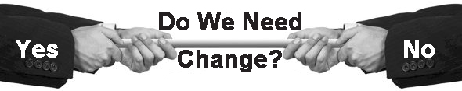
Resistance to Change
It is the general tendency (habit) of human being to resist change, no matter how much beneficial the program is. It is always difficult to implement change program. Almost all organizational change efforts face one or more forms of resistance to change. The resistance may be overt as well as covert (exposed and hidden). It may further be individual or organizational.
Managers Vs. Employees

Slide 17
Sources of Resistance to Change
Sources of resistance to change are illustrated below:

Slide 18
Individual Resistance to Change
It is the general tendency (nature) of people to resist change. They resist change due to various reasons like habit, perception and other economical and social reasons. In other words, there are a number of reasons why people resist change. Some of them are:

Slide 19
Organizational Resistance to Change
Another category of resistance to change is organizational resistance to change. In other words, Resistance may also be present at organizational level. Some organizations are so designed that they resist innovations. Some of the important sources in this category are explained below.

Slide 20
Overcoming (Managing) Resistance to Change
the change programs effective managers need to overcome resistance to change successfully. Six tactics have been suggested by change agents in dealing with resistance to change. They are explained below.

Slide 21
Approaches to Managing Organizational Change
There is no shortage of approaches to manage organizational change. Experts have suggested a number of approaches to manage the organizational change. Here, we discuss three major approaches as explained by Robbins and his colleagues. These approaches are used throughout the world.

Slide 22
Lewin's Three-Step Model (Force Field Analysis)
As the need and objectives of change are recognized and realized, the management must choose and introduce approach that works better. In the year 1951, Kurt Lewin, a pioneering social psychologist, has developed a new way of looking at change. His model is also called force field analysis.

Slide 23
Concept of Action Research
AR is becoming very popular these days. A primary change process used in most OC/OD program is action research. It is data-based problem solving process of organizational change. AR closely follows the scientific method. It represents a powerful approach to organizational change. Lets go through the following definition of AR.

Slide 24
Nature of Action Research
The nature of action research can be explained through following points.
Unlike other approaches AR can be started at any level depending on where the problem is felt and who are concerned with it.
AR is always problem-oriented and some problem can be taken up without getting into other areas of the organization.
The major concern of AR is building research competence in the organization. Therefore, it assists people to develop skills of diagnosis, action planning and evaluation.
Major concern of AR is the integration of theory and research and also of process (McShane & Glonow).

Slide 25
The Action Research Approach to OC/OD

Slide 26
Steps in the Action Research
The steps in the action research are:
1. Establish Client Consultant Relationship
2. Diagnose the Need for Change
3. Introduce Intervention (Change)
4. Evaluate and Stabilize Change
5. Disengage Consultant's Service

Slide 27
Concept of Organizational Development
Organizational development (OD) is a practical and systematic approach to launching and spreading change in organizations. It is an effort to improve the overall organizational efficiency. It is basically a long range program attempting to change behavioral attitudes and performance of total organizations. Organizational development reflects (shows) a broad and comprehensive approach to individual organization relationships. The word organizational development was coined by Richard Beckhard in the mid 1950s. He developed this concept as a response to the need for integrating organizational needs with individual needs.

Slide 28
Characteristics of OD
The key characteristics of OD are explained as follows:

Slide 29
OD Values
OD is a value based concept– it is not free from ethics and morality. Therefore, OD programs are based on certain value systems. The primary objective of OD is to change the total system of the organization.

Slide 30
OD Objectives and Goals
OD programs are always objectives/goal oriented. Some of the important (normative) goals and objectives of OD are:
Improvement in interpersonal competence;
A change in value systems so that human factors and feelings can be considered legitimate;
Development of enhanced inter-group and intra group understanding to minimize tension;
Development of more effective team management (e.g. the capacity of the functional groups to work effectively);
Development of better methods of conflict resolution instead of usual bureaucratic methods;
Development of an organic system rather than a mechanic system, etc.

Slide 31
OD Process (Steps in OD)
It is highly essential to outline a series of steps, or phases, that characterize the OD process in general. OD process are illustrated below:

Slide 32
OD Interventions
(Approaches to OD/Techniques of OD)
There are a number of OD approaches/ techniques available for the purpose of interventions to be used by managers as per the organizational requirement.

Slide 33
Individual Interventions (Micro Level)
Sometimes the diagnosis and feedback steps of OD lead to the conclusion that organizational problems have their roots in certain shortcomings at individual organization members. In this type of situation such intervention activities need to be designed that will enable organization members to develop the abilities or skills they currently lack. Such activities can take a variety of forms (Arnold & Feldman).
1. Counselling and Coaching
2. Sensitivity Training
3. Survey Feedback

Slide 34
The Survey Feedback Process
The survey feedback process includes following:

Slide 35
Process Interventions (Group /Meso Level)
Process interventions are designed to improve the interaction process between individual members, among members of work groups or teams. They can also be designed between groups or departments in the organization.

Slide 36
System-wide/Systemic Interventions (Organizational /Macro Level)
They are the macro-level interventions. Generally, they try to bring changes throughout the organizations. Their focus is towards bringing changes in the organizational systems as a whole. Import techniques used in this level are:

Slide 37
Benefits and Limitations of Organization Development
Benefits and limitations of organization development are tabulated below:
Benefits | Limitations
Change throughout organization Greater motivation Increased productivity Better quality of work Higher job satisfaction Improved teamwork Better resolution of conflict Commitment to objectives Increased willingness to change Reduced absences Lower turnover | Major time requirements Substantial expense Delayed payoff period Possible failure Possible invasion of privacy Possible psychological harm Potential conformity Emphasis on group processes rather than performance Possible conceptual ambiguity Difficulty in evaluation

Slide 38
Thank you

